Slide 1
Hard Skills
Learning Objectives:
Students will define a hard skill.
Students will identify hard skills from a list of traits, strengths and weaknesses.
Students will evaluate and rate a list of hard skills.

Slide 2
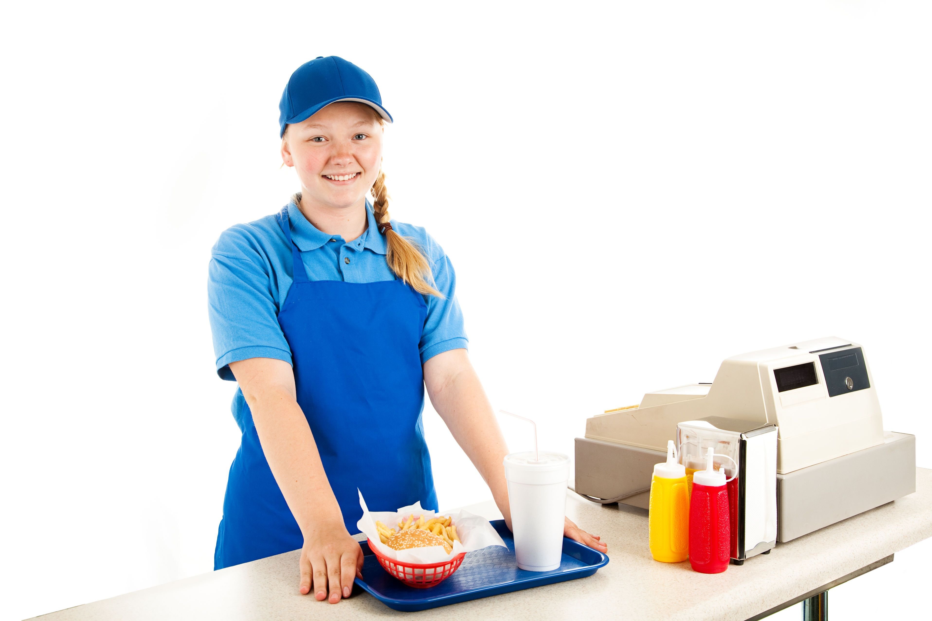
Three choices for a summer job, which one would you like best? Why?

Slide 3
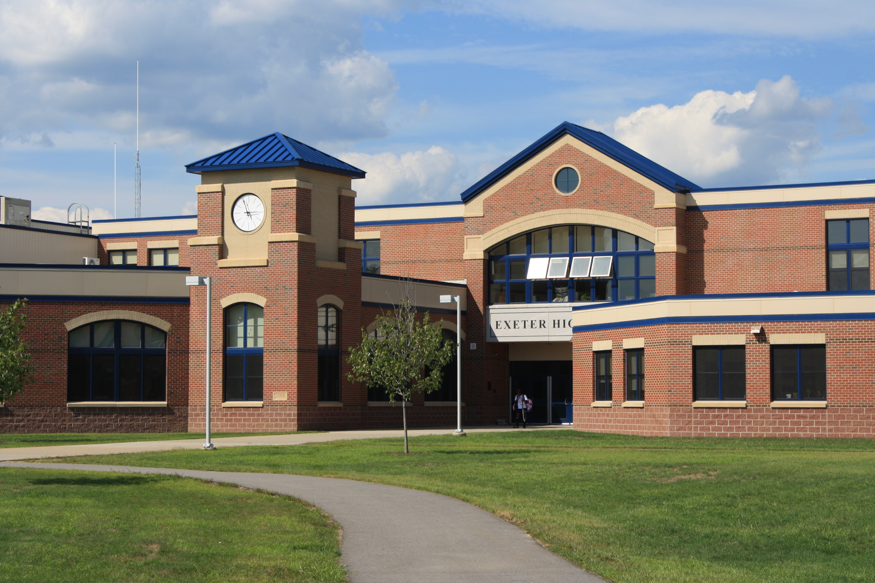
Where would you learn to do some of these job responsibilities?

Slide 4
Sometimes when two words are put together in English they form a new meaning.
Compound Words: open, closed, and hyphenated
child + care
one + half
mass + produced
childcare
one-half
mass-produced
French + fry
foot + ball
weather + man
fork + lift
French fry
fork lift
football
weatherman

Slide 5
hard + skills
hard skills
?
What does this word mean?

Slide 6
Hard Skills are the learned skills or training that you need for jobs or careers
Examples Include:
Reading
Typing
Cleaning
Writing
Driving
Cooking
Math
Using Power Tools
?
Are any of these hard skills also a strength of yours?

Slide 7
Hard Skills for Nursing:
Provide medical care (test blood pressure and read/interpret results)
Use medical equipment
Provide physical care of patient (cleaning, feeding)
Manage records
Transport patients

Slide 8
What HARD SKILLS does this worker need at a fast food restaurant?

Slide 9
What HARD SKILLS does this childcare worker need in a child care setting?

Slide 10
What HARD SKILLS does this worker need at a hardware store?

Slide 11
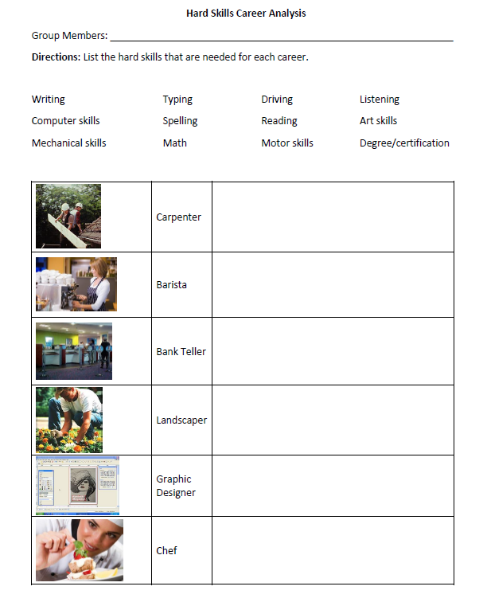
Your Turn:
What hard skills are needed for each job?

